Slide 1
ANNUAL PLANNING 2014
Cornell Alumni Leadership Conference: January, 2014
Presenter: Sheryl Hilliard Tucker
Trustee, Cornell University Board of Trustees
Chair, Cornell Mosaic

Slide 2
Annual Planning FY2014
TODAY’S AGENDA
Why Planning Is Important
Putting A SWOT Analysis To Work
Making Your Goals Smart
“Play To Win’ Strategy for Achieving Your Goals
Recruiting The Best Board
Next Steps

Slide 3

Why does planning get such a bum rap?

Slide 4

The value of planning

Slide 5
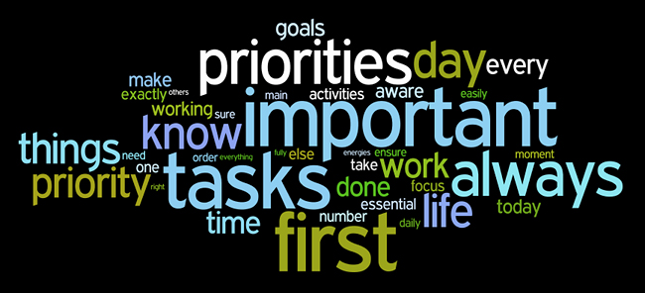
Planning helps groups identify and focus on their priorities

Slide 6

Annual Planning for FY2014

Slide 7
What is an Annual / Work Plan?
An ANNUAL PLAN is your roadmap to the future.
  Outlines how an organization plans to fulfill its mission with maximum efficiency and impact.
  Includes specific goals and the action steps (tactics) and resources needed to accomplish them.
  Developed with input from your Board, Committees and your Cornell Alumni Affairs staff liaison (if you have one).
A WORK PLAN is a coordinated set of tasks for carrying out the goals outlined in the Annual Plan.
  Clarifies roles for board and committee members, resources required and time frames.

Slide 8
Cornell’s template for an
Annual / Work Plan

Slide 9

Start your annual planning with a SWOT analysis
A SWOT is a snapshot of your organization’s current status

Slide 10
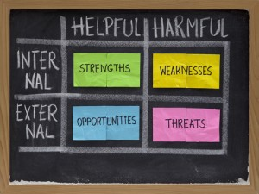
The building blocks of a SWOT
Examples of STRENGTHS?
Examples of WEAKNESSES?
Examples of OPPORTUNITIES?
Examples of THREATS?

Slide 11
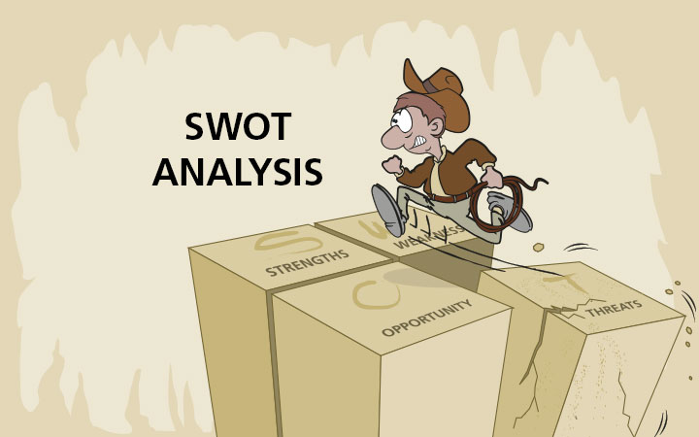
Putting your SWOT to work
  How can we leverage our STRENGTHS?
  How can we improve each WEAKNESS?
  How can we benefit from each OPPORTUNITY?
  How can we lessen each THREAT?

Slide 12

Turn your SWOT into GOALS

Slide 13
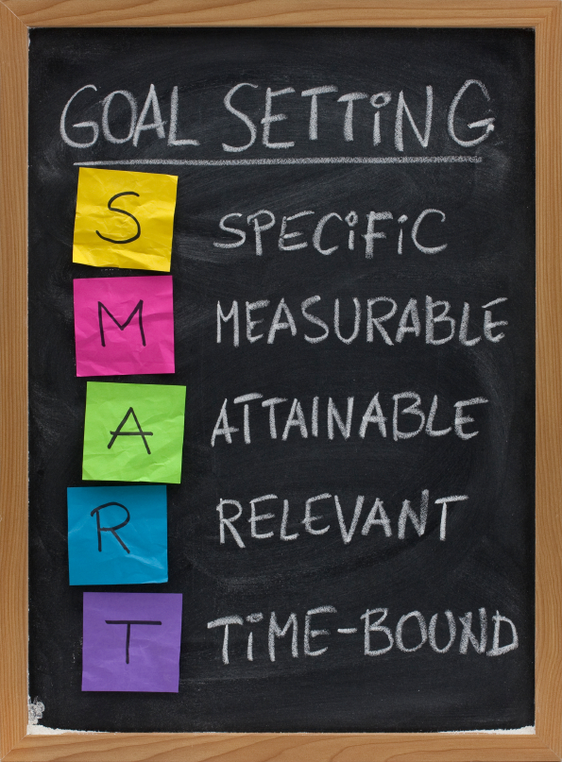
Make your goals S.M.A.R.T.

Slide 14
Support your goals with a “PLAYING TO WIN” strategy*
Answering these 5 questions can help you turn your goals into a successful annual plan
  What is your winning aspiration (goal)?
  Where will you play?
  How will you win?
  What capabilities must be in place?
  What management systems are required?
  *Adapted from Playing to Win, a groundbreaking strategy book by A.G. Lafley and Roger Martin.

Slide 15

Playing to Win Strategy
What is your Winning Aspiration?
  Think of your Winning Aspiration as a Big Hairy Audacious Goal or BHAG
  Focus on what it will do to better serve your active alumni group members, the alumni you want to attract and, of course, CORNELL.
  Make sure your goal is ambitious and forces your board to stretch a bit to accomplish it.
  Keep the mission of your alumni organization in mind when you identify your goal.
  Make sure your goal is SMART.

Slide 16

Playing to Win Strategy
Where will you play?
  Define the playing field(s) that you will need to target to achieve your goal.
  Targets may include young alumni, diverse alumni, older alumni, alumni from a specific college, alumni with marketing experience or other specific skills, wealthy alumni, high-profile alumni, staff or faculty that can provide the resources or expertise you require

Slide 17

Playing to Win Strategy
How will you win?
  Think about how you will achieve your goal on your chosen playing field (e.g. geographic region, target market, etc.). This is your unique value proposition.
  Be specific and compelling when you describe how you will your goal.
  Think through what winning in respect to your goal will look and feel like. It’s easier to accomplish your goal when you have the results pictured in your mind.

Slide 18
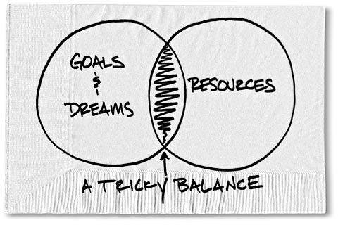
Playing to Win Questions
What capabilities must be in place?
  Determine the core capabilities and resources you require to achieve your goal. This includes specific skills, resources, networks, Cornell staffing support, etc.
  Be honest about the state of your capabilities. Assess what will be required to keep or attain the capabilities you require.
  Play to the unique strengths of your board, committees and go-to alumni — or recruit individuals to your board and committees who have the skills / networks you need.
  Remember that the Cornell Office of Alumni Affairs and Development’s goal is to help you achieve your goals.

Slide 19

Playing to Win Strategy
What management systems are required?
  Make sure you have the right systems, schedules. metrics, check-in points, approval process, etc., you need to achieve your goals.
  Determine how you will communicate your goals and strategy in a simple, but clear way.
  Clarify how you want to monitor your progress and keep your goals on track.
  Define measures that will tell you, over the short- and long-run, how successful you are in achieving your goals.

Slide 20
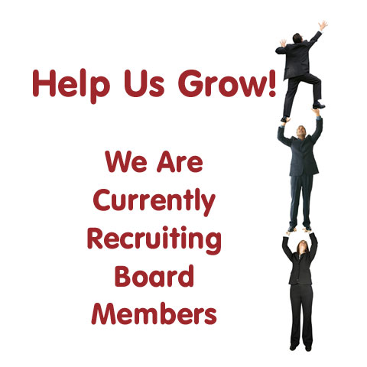
Build a “Playing to Win” Board and leadership team
Evaluate your approach to recruiting board members.
Make recruitment part of every board member’s job, even if you give the detailed work to a committee.
Set recruitment goals and timelines.
Celebrate successes.

Slide 21

Fill leadership positions with with your ANNUAL PLAN in mind
  Discuss what skills and expertise would make the board stronger and more dynamic.
  Avoid the tendency to recruit board members just like the alumni already serving on the board.
      Remember, diversity often sparks innovation. Identify people who share the core values of the organization, but perhaps provide a different perspective or worldview.
  Be very careful about recruiting alumni just for their administrative or management skills. Your leaders must be passionate about your organization and want to work on behalf of Cornell and our alumni community.

Slide 22
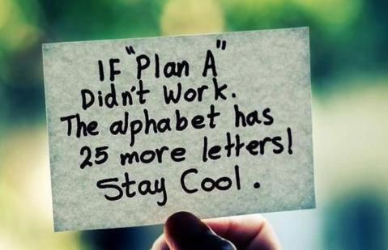
Final advice . . .

Slide 23


